Slide 1
Cytokinesis
Divides cytoplasm
Animal Cells
Microfilaments constrict/pinch the cytoplasm
Plant Cells
Cell plate forms between two daughter nuclei
Cell walls then form on either side of cell plate

Slide 2
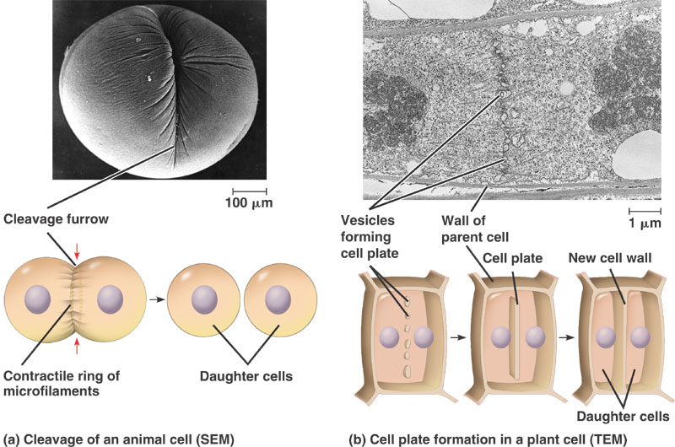

Slide 3
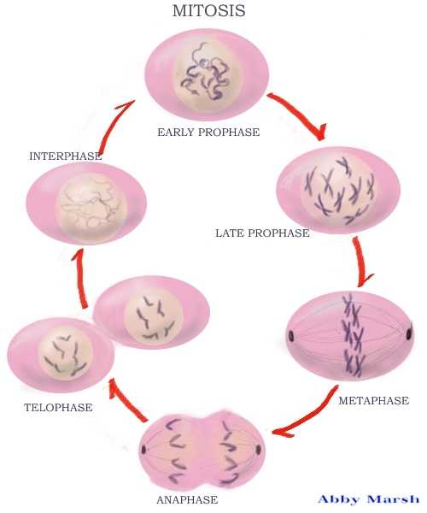
Mitosis Review
Interphase
Prophase
Metaphase
Anaphase
Telophase
Cytokinesis
MITOSIS

Slide 4
Meiosis ”gametes”, with half the number of chromosomes, are produced.
During Meiosis diploid cells are reduced to haploid cells
Diploid (2n) → Haploid (n)
If Meiosis did not occur the chromosome number in each new generation would double…. The offspring would die.

Slide 5
MEIOSIS
Interphase
Meiosis I
Meiosis II
Prophase I
Metaphase I
Anaphase I
Telophase I
Prophase II
Metaphase II
Anaphase II
Telophase II

Slide 6
2n
2n
4n
Meiosis I
Interphase/ DNA replicates
2n
Meiosis II
n
n
n
n

Slide 7
Prophase I - Synapsis
Homologous chromosomes
sister chromatids
sister chromatids
Tetrad

Slide 8
Homologous Chromosomes (because a homologous pair consists of 4 chromatids it is called a “Tetrad”)
eye color
locus
eye color
locus
hair color
locus
hair color
locus
Paternal
Maternal

Slide 9
Meiosis I
Interphase –replication
Prophase I - homologous chromosomes pair
Crossing over! - creates variation (diversity)
nonsister chromatids
Tetrad
chiasmata: site of crossing over

Slide 10
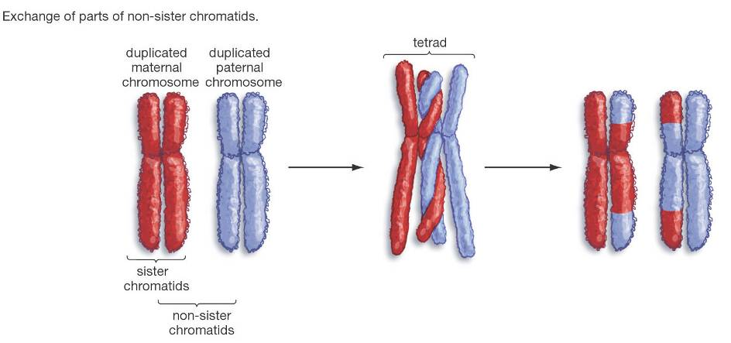

Slide 11
Meiosis I
Metaphase I
Homologous pair line up at center (tetrad)
INDEPENDENT ASSORTMENT OCCURS:
1. Orientation of homologous pair is random
2. **Variation**
produces 2^{n} distinct gametes, where n = the number of unique chromosomes.
In humans, n = 23 and 2²³ = 6,000,000

Slide 12
Meiosis I
Anaphase I
Homologous pairs move to opposite sides of cell
Telophase I/Cytokinesis
Cell divides

Slide 13
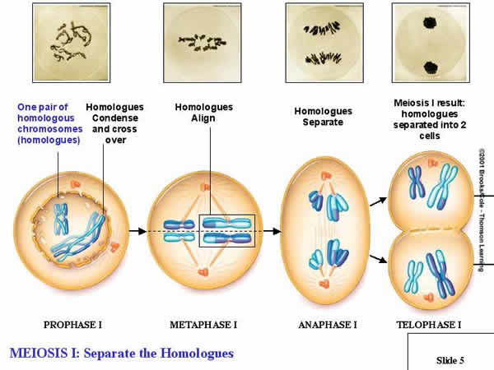

Slide 14
Quick Questions
How many cells are at the end of Meiosis 1?
How many chromosomes are in each cell at the end of meiosis 1?

Slide 15
2n
2n
4n
Meiosis I
Interphase/ DNA replicates
2n
Meiosis II
n
n
n
n

Slide 16
Meiosis II
Prophase II - no DNA replication!!!
Metaphase II
Anaphase II
Telophase II/Cytokinesis

Slide 17
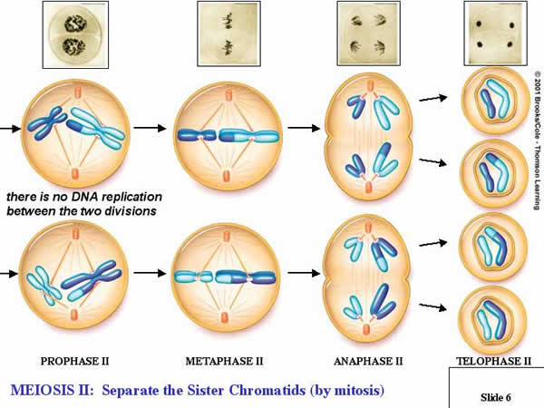

Slide 18
Quick Questions
How many cells are at the end of Meiosis 2?
How many chromosomes are in each cell at the end of meiosis 2?

Slide 19
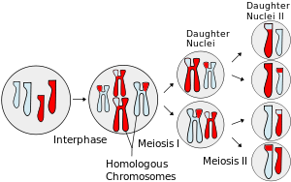
How many cells are at the end of meiosis? How many chromosomes are in each cell?

Slide 20
 | Meiosis | Mitosis
Two cell divisions
Half the original chromosomes
Homologous Chromosomes pair up
Cytokinesis
Four daughter cells
46 Chromosomes at end

Slide 21
Mitosis vs. Meiosis
1. Number of Cells
Mitosis creates 2 identical cells
Meiosis creates 4 individual cells
2. Number of chromosomes
Mitosis creates cells with 46 chromosomes (2n – diploid)
Meiosis creates cells with 23 chromosomes (n – haploid)
3. Locations
Mitosis – somatic (“normal”) cells
Meiosis – gametes (sex) cells

Slide 22
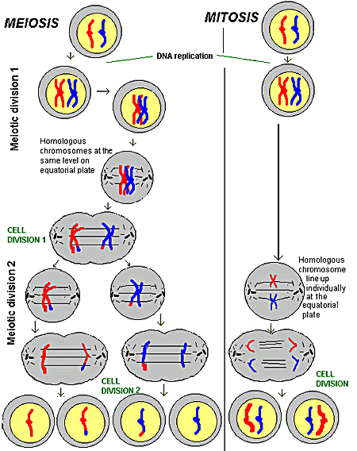

Slide 23
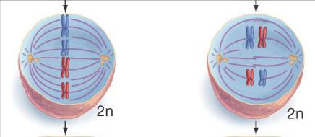
The Key Difference Between Mitosis and Meiosis is the Way Chromosomes Uniquely Pair and Align in Meiosis
Mitosis
The first (and distinguishing) division of meiosis

Slide 24
Whiteboard Questions
If a cell has 40 chromosomes, how many are in each cell at the end of meiosis 1?
Meiosis 2?
Mitosis?
T/F: Mitosis creates 2 different cells
T/F: A difference between meiosis & mitosis is that meiosis occurs in gametes and mitosis occurs in somatic cells.

Slide 25
 | Meiosis | Mitosis
Chromosome Number: | Reduced by half (haploid) | Remains the same (diploid)
Pairing of Homologues: | Yes | No
Function: | sexual reproduction | Cellular (asexual) Reproduction; general growth and repair of the body
#of Divisions: | 2 | 1
#of Cells produced: | 4 | 2
Creates: | Sex cells (Gametes) | Somatic Cells
Crossing Over: | Yes | No
Genetically: | different | identical

Slide 26
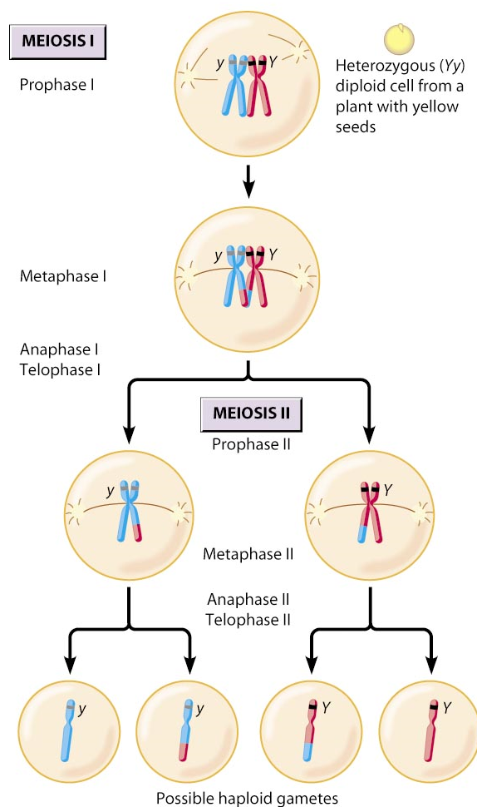
Importance of Meiosis
Genetic Variation
Random distribution of chromosomes
Chromosomes are passed to offspring independently of each other

Slide 27
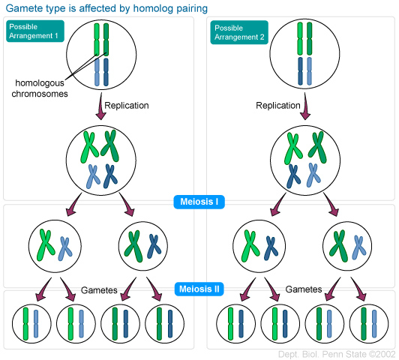

Slide 28
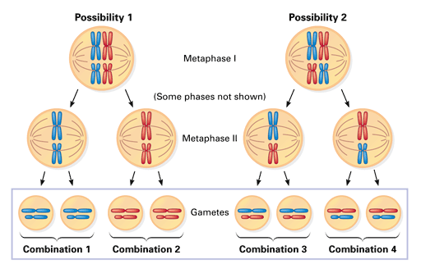

Slide 29
A Sweet Animation!!!!!!!!!!!!!!!!!!
http://wps.prenhall.com/esm_freeman_biosci_1/7/1948/498784.cw/index.html

Slide 30
Fertilization
The fusion of a sperm and egg to form a zygote.
A zygote is a fertilized egg
sperm
n=23
n=23
egg
2n=46
zygote

Slide 31
Asexual reproduction
Asexual reproduction involves a single parent.
genetically identical offspring
All prokaryotes and some eukaryotes
can be very rapid
allows them to crowd out other organisms that reproduce more slowly

Slide 32
Three types of asexual
Binary fission - a parent cell splits into two identical daughter cells (E. Coli)
Fragmentation - a parent organism breaks into pieces and each piece develops into a new organism (Starfish – sailors thought they were killing them… not so much ☺)
Budding - a parent cell forms a bubble-like bud. The bud stays attached to the parent cell while it grows and develops. When the bud is fully developed, it breaks away from the parent cell and forms a new organism.
- JELLYFISH don’t rely solely on budding to reproduce – 1st release a sperm & egg into the H20. Zygote grows into a basic organism called a polyp, which lives attached to the base of a rock. The polyp then grows, before releasing a genetically identical bud of itself, that grows into an adult jellyfish.

Slide 33
Sexual Reproduction
involves two parents
parents produce gametes
Gametes are haploid cells
two gametes unite is called fertilization
The fertilized cell is a zygote .
A zygote is diploid cell

Slide 34
Sexual vs. Asexual Reproduction
Asexual
Sexual
Organisms inherit all chromosomes from single parent
Genetically identical
Little energy
No mate needed
Good for stable env’t
Bacteria
Chromosomes from 2 parents
Genetic variation
Good for changing env’t
Most animals/organisms
Why reproduce sexually?
Greater chance of beneficial mutations
Crossing over, random assortment

Slide 35
Check the correct box for each description
 | Meiosis | Mitosis
1. Two cell divisions
2. Occurs in gametes
3. Half the original chromosomes
4. Homologous Chromosomes pair up
5. Creates identical cells
6. Four daughter cells
7. Same #of chromosomes at end

Slide 36
2. Metaphase I
1. Prophase I
3. Anaphase I
4. Telophase/Cytokinesis I

Slide 37
3. Anaphase II
Prophase II
Cells from Meiosis I
2. Metaphase II
4. Telophase II
/Cytokinesis II

